Slide 1
PREDICTION OF READMISSION OF DIABETIC PATIENT
-by Smart Predictors

Slide 2
PROBLEM STATEMENT
Diabetes is linked to an increased likelihood for a number of serious, sometimes life-threatening complications.
Proper diabetes management can reduce the risk of complications and improve quality of life.
However, little is known about which aspects of disease management and patient care factors or what combination of the factors may predict an acute situation that leads to unnecessary hospitalizations.

Slide 3
OBJECTIVES OF RESEARCH
Diabetes is historically categorized into two categories, Type 1 and Type 2.
The objective of Project is to determine whether many independent variables or combinations of variables help to predict a diabetes-related hospital readmission for patients with diabetes.
A convenience sample of 11 historical medical records of patients who were admitted to a rural hospital with a diagnosis of, or relating to, diabetes has studied.
The results of the analysis returned prediction of variable combinations that correctly classified cases for readmission.

Slide 4
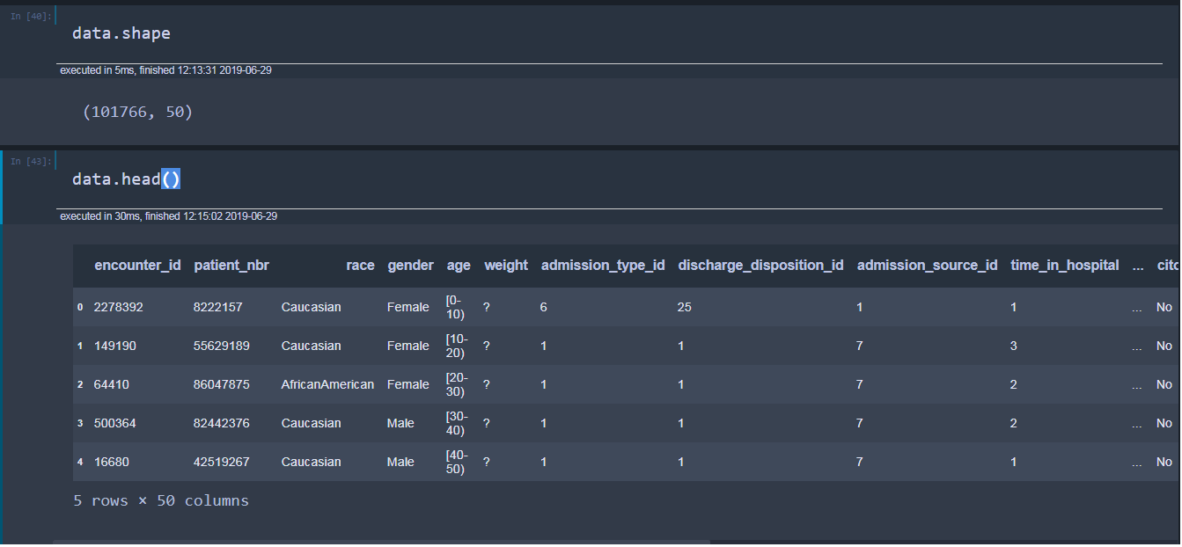
TABLE DEFINITION

Slide 5
DATA MODELLING
We have our final dataset.
We train the model in a way that it can predict (almost) correct results.
In this dataset, we filled missing values using mean, median mode methods.
We have split the data into train and test.
We will train the model on training data and predict the results on the test data.

Slide 6
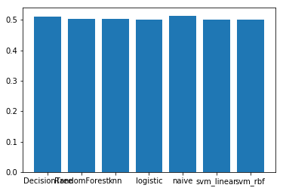
APPROCH
For this project we will use all the algorithms and find best algorithm.

Slide 7
BEST ALGORITHM
Before jumping into the code, let's get a little background about the SVM RBF kernel.
Support Vector Machine (SVM) is a supervised machine learning algorithm which can be used for either classification or regression challenges.
In this algorithm, we plot each data item as a point in n-dimensional space (where n is number of features you have) with the value of each feature being the value of a particular coordinate.
Then, we perform classification by finding the hyper-plane that differentiate the two classes very well.

Slide 8
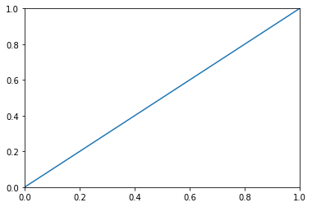
PLOTTING
accuracy score(y_pred3,y_test)
0.88812460079595146

Slide 9
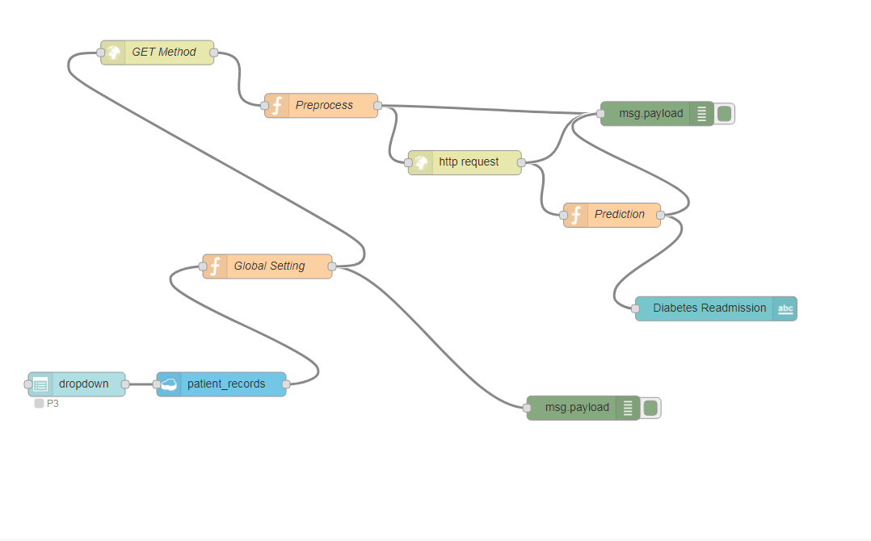
Application creation using Node Red

Slide 10
CONCLUSION
While each predictor model for hospital readmission of diabetes patients demonstrated both statistical and practical significance, the overall hit rates were impressive.
Most Accurate Model Based on the findings of this study, it can be concluded that, for this sample, the most accurate prediction of readmissions to the hospital for conditions caused by or related to diabetes within a period of time for patients with diabetes.

